Slide 1

NUM2 TASK 1: DATA CLEANING
Nina S. Gooden
Student ID: 009823504
Instructor Name: Eric Straw

Slide 2




Research Question
Can the communications company in question predict which customers are most likely to add to the churn rate?
If so, is there a significant statistical feature that contributes to the existing churn?
Tuesday, September 15, 2022

Slide 3

Data Set
The data consists of 10K customer records for a communications company. The target variable for measurement is labeled “Churn”—an indicator of whether a customer has stopped service in the past month.

Slide 4
Predicting Variables
Services
Account Information
Customer Information
Indicate which products a particular customer has signed up for on their account. Examples:
InternetService
Phone
OnlineSecurity
OnlineBackup
DeviceProtection
Provides information about the account type and health for a particular customer. Examples:
PaperlessBilling
PaymentMethod
Tenure
Bandwidth_GB_Year
Outage_sec_perweek
Provides insight about specific customer qualifications and demographics for statistical sampling. Examples:
Techie
Age
Income
Gender
Marital

Slide 5
Data Types: Mixed
NUMERICAL (Primarily Information)
CATEGORICAL (Primarily Services)
Tenure
Bandwidth_GB_Year
Outage_sec_perweek
Age
Income
PaperlessBilling
Gender
Phone
Techie
OnlineSecurity
DeviceProtection

Slide 6



Agenda: Plan for Cleaning “Churn” Data
Proposal: techniques and steps to identify specific anomalies from the data
Justification: identifying approach for qualifying data duality
Clarification: selecting programming language/libraries/packages for process
Coding: providing code used to identify outstanding data

Slide 7
Proposal
Step 1
Utilize Visual Studio Code to build a coding environment for the analysis.
Step 2
Import the pandas library to utilize in a Python-based data set clean via the read_csv command.
Step 3
Evaluate the existing data structure and ultimately create a primary dataframe titled “churn” for the analysis, along with relevant slices.
Step 4
Evaluate data for user error, statistical outliers, and missing data.
Step 5
Impute missing data using central tendency or remove outliers that are beyond the measured standard deviation.

Slide 8
Justifications of Approach
Approach
Due to the fact that the company has provided such extensive data for the evaluation, a standard cleaning procedure seems appropriate. My primary concern is centered around missing data for certain columns—for example, there are many NaN values in tenure which may affect my analysis—but there is enough relevant information to warrant a standard deviation adjustment for those.
Lastly, because I am used to the process of cleaning data and removing missing values, I will make every attempt to replace those NaN values with statistically sound values because I have so much information available.

Slide 9
Justifications of Tools
Tools
I have opted to use Python for this evaluation because it is the programming language that I am the most comfortable with. In addition, after much deliberation, I have come to the conclusion that Python is more relevant in my industry than R seems to be.
“Python's continuous rise in popularity comes at the expense of the decline of popularity of other programming languages,” the folks behind the TIOBE Index are quoted to having said. (Woodie, 2019)
I use Jupyter notebooks, Numpy, Pandas, and Matplotlib in my professional life, and foresee needing to continue to utilize the libraries going forward. It made sense to continue to use this stack, since it was also used in the DataCamp coursework for Python. I included scikit and scilearn later in my evaluation.
Finally, I use VSC as my text editor because I like having one tool that can switch between languages when working in larger environments.

Slide 10
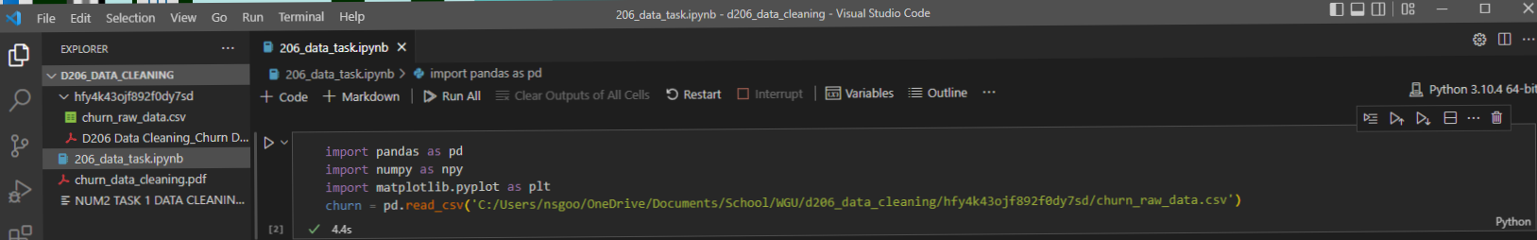
Providing the Code
Importing the necessary libraries.
Converting the csv file into a dataframe.

Slide 11
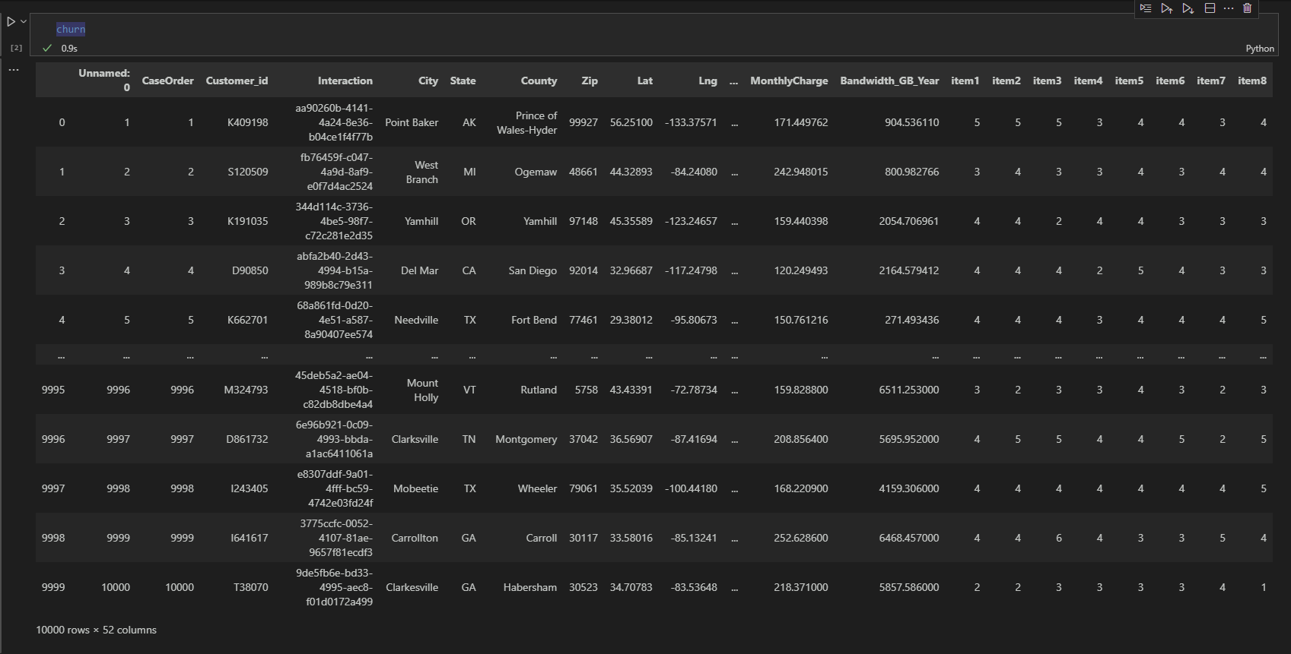
Providing the Code
Looking at the dataframe to evaluate contents. I quickly realized I needed more information about the specific columns.

Slide 12
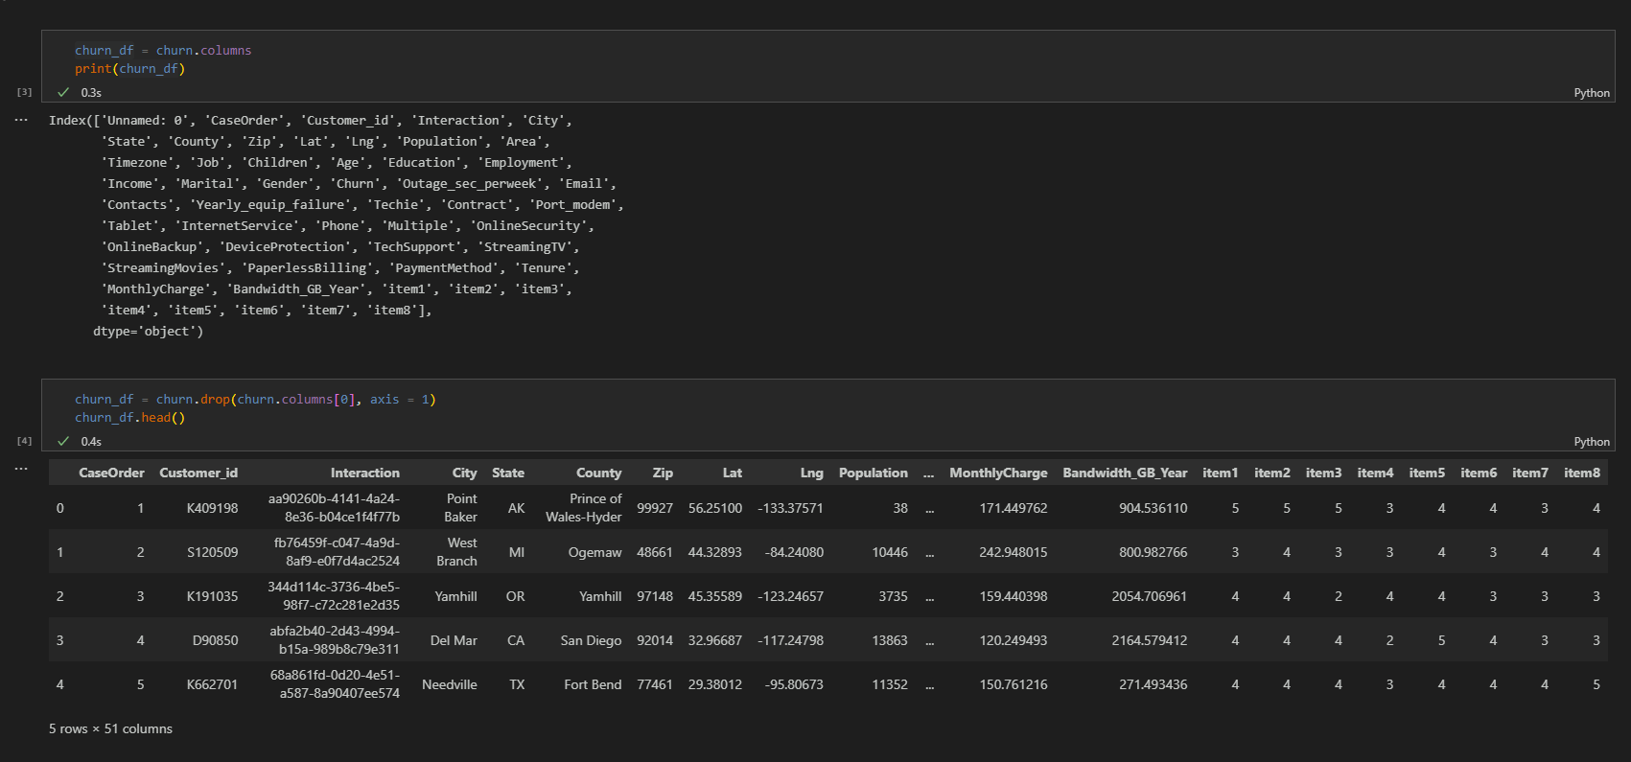
Providing the Code
After listing the columns, I realized there was one marked “Unnamed,” so I got rid of it. I also truncated the information.

Slide 13
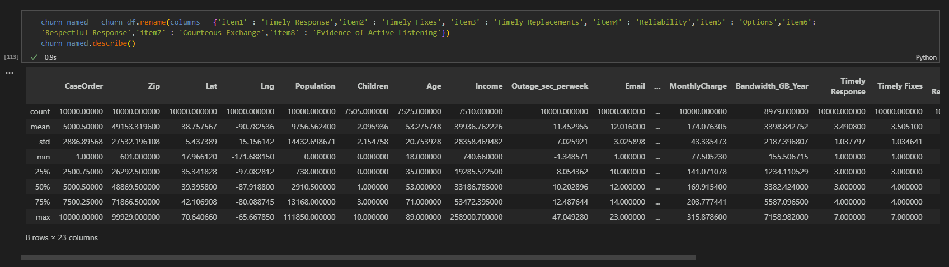
Providing the Code
I renamed the “item” columns for clarity, based on the data notes provided.

Slide 14
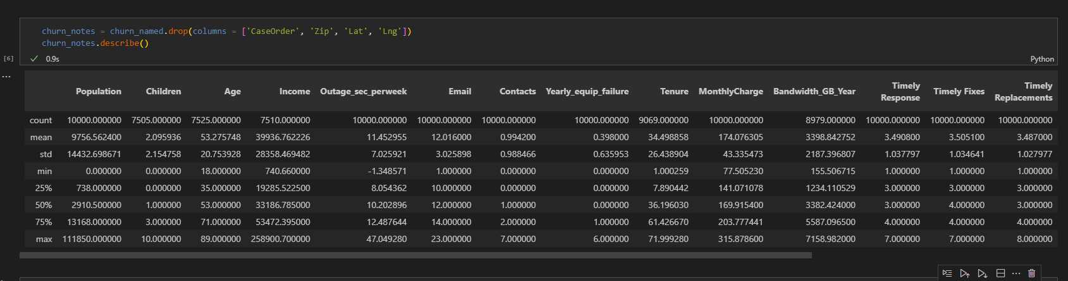
Providing the Code
I removed columns that did not contribute to the analysis. I also went back and renamed the dataframe I’d created with the renaming for clarity.

Slide 15
Agenda: Data Cleaning
Document findings and anomalies
Justify mitigation methods
Summarize outcome of all data-cleaning steps
Offer code used to mitigate any extraneous data
Prove data cleaning proficiency by providing cleaned data set
Gather any limitations of the process

Slide 16
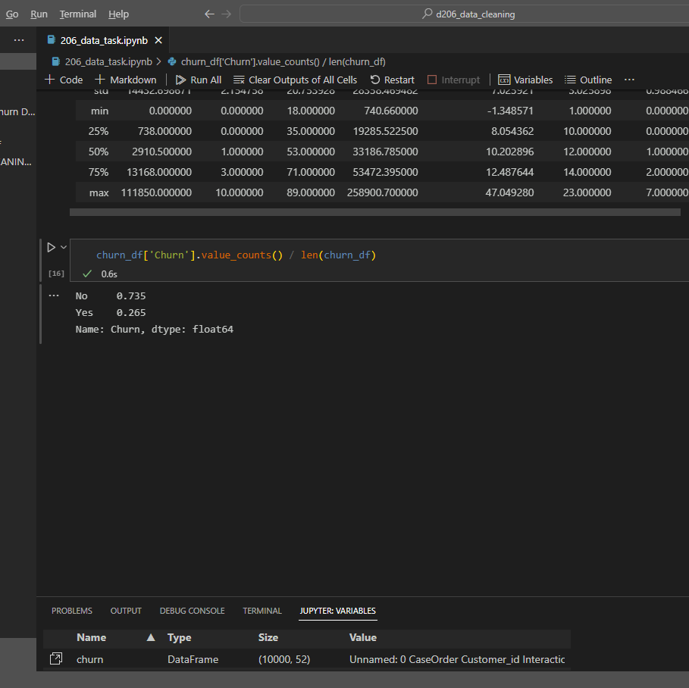
Data Cleaning
First, I found the overall ratio for Churn
The No/Yes percentage was 73% to 26%.
I would later compare this percentage to each significant component to ascertain if this rate was contributed to based on those components.

Slide 17
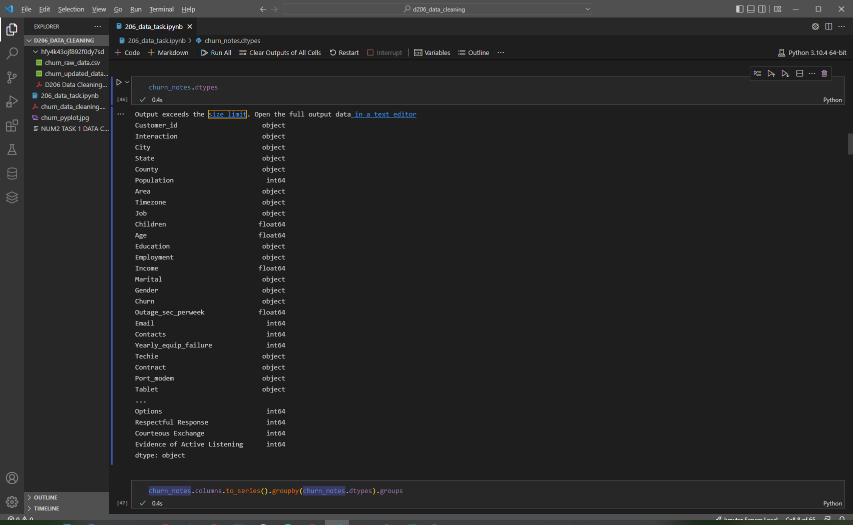
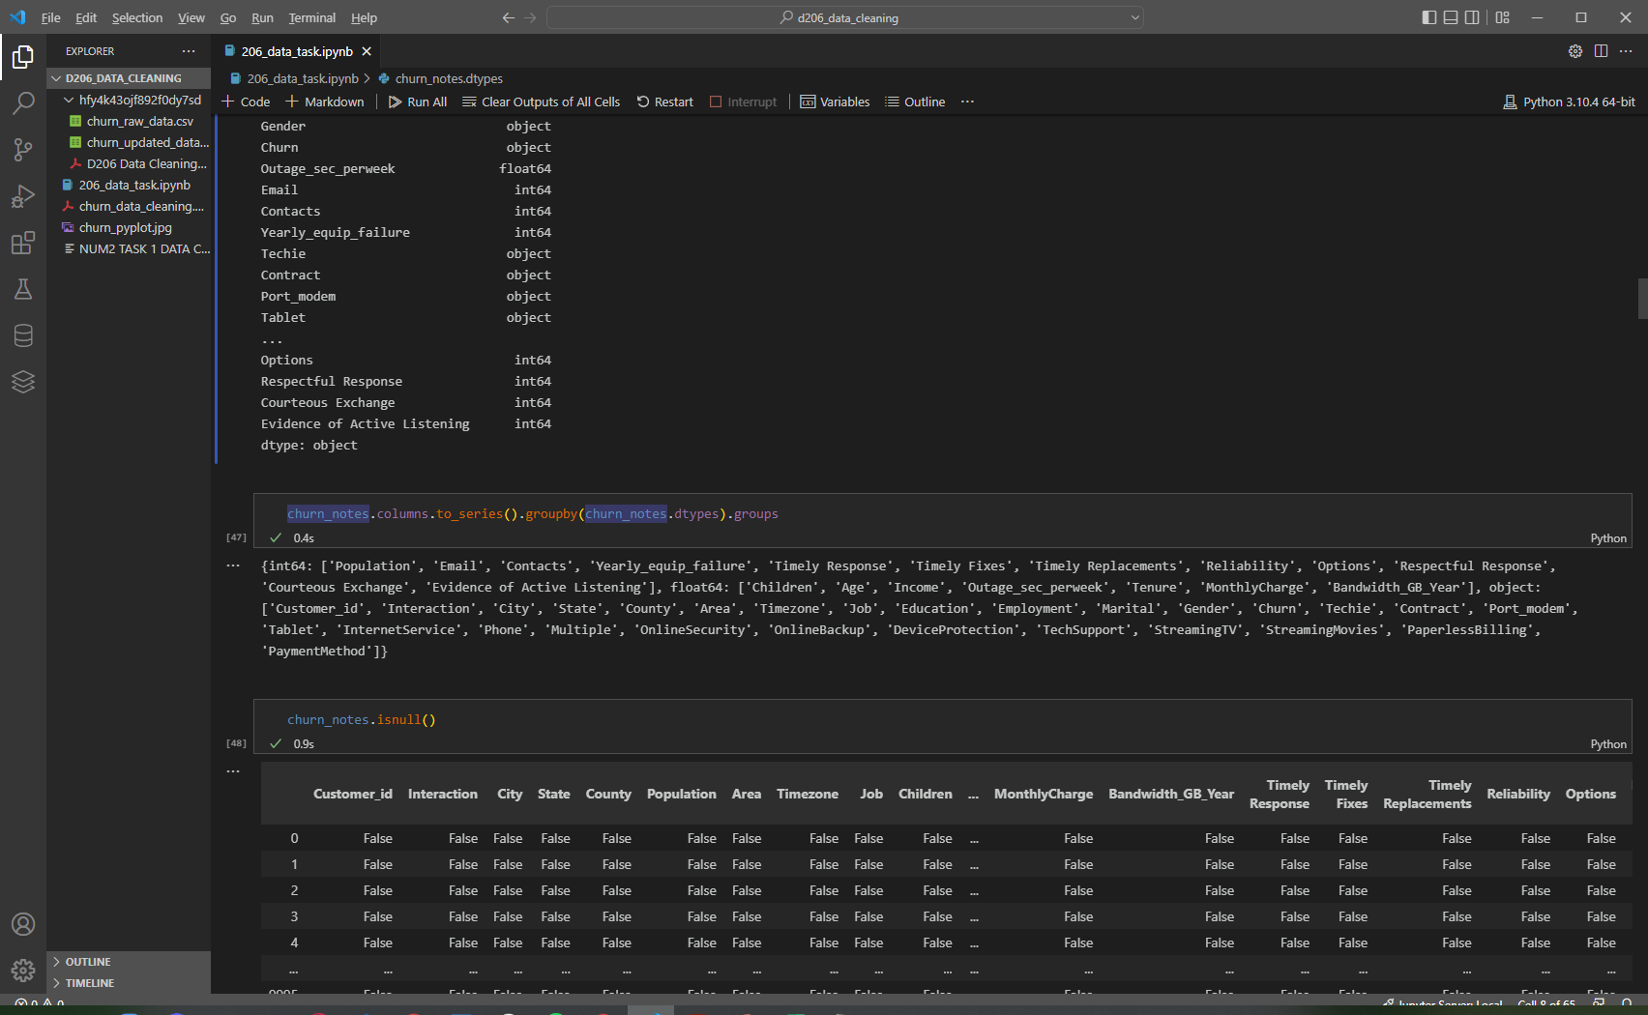
Identifying Missing Values
Step 1
First, I had to confirm data types across columns using churn_notes.dtypes
Step 2
Organize columns by data type!

Slide 18
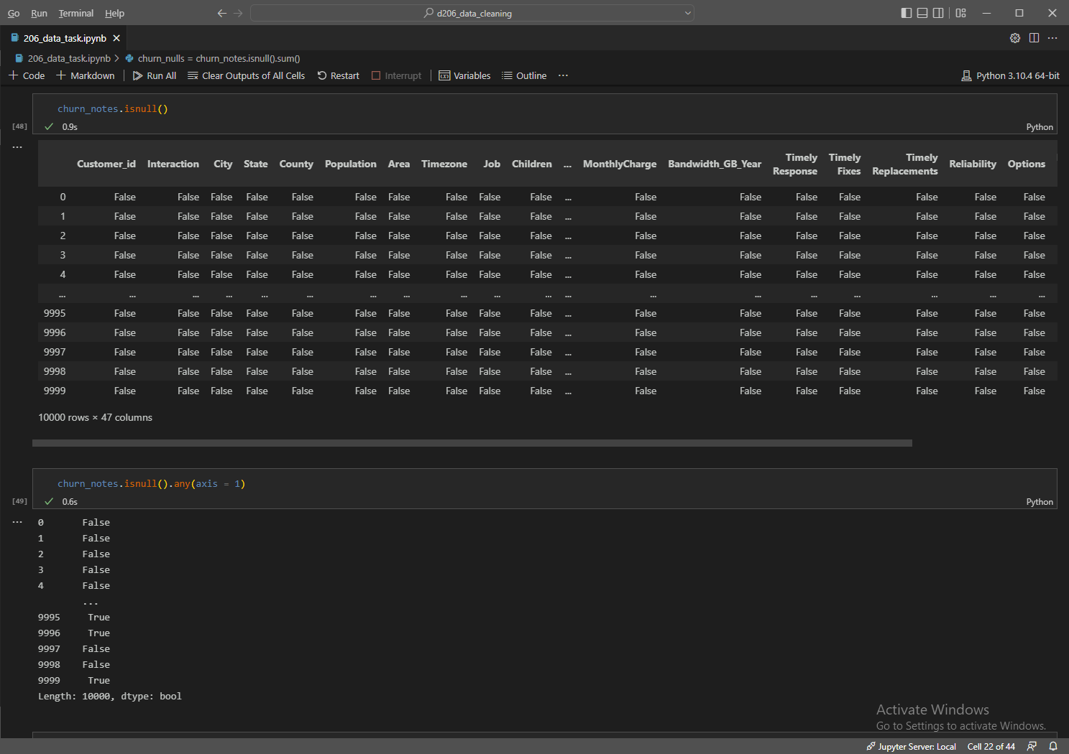
Identifying Missing Values
Step 3
First, I looked at all of the null values in the entire dataframe, then I broke it down into which rows had null values.

Slide 19
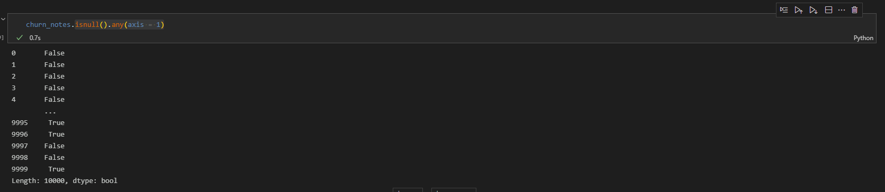
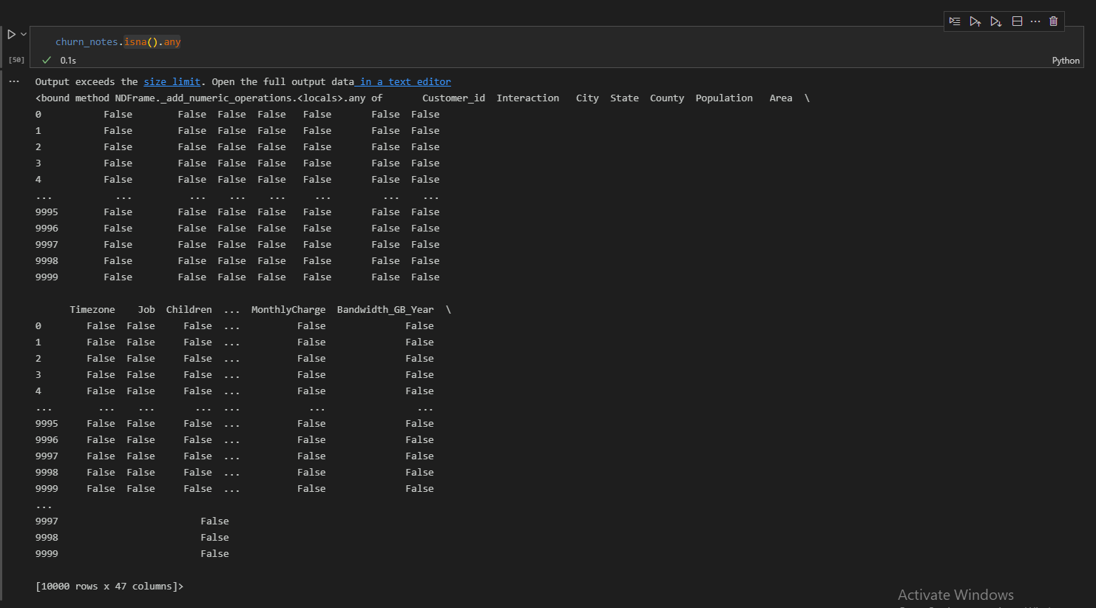
Adjusting Missing Values
I needed to get a closer look at which columns had the most null values so I could determine if they were strictly necessary for my evaluation.
First, I looked at the overall columns with nulls.

Slide 20
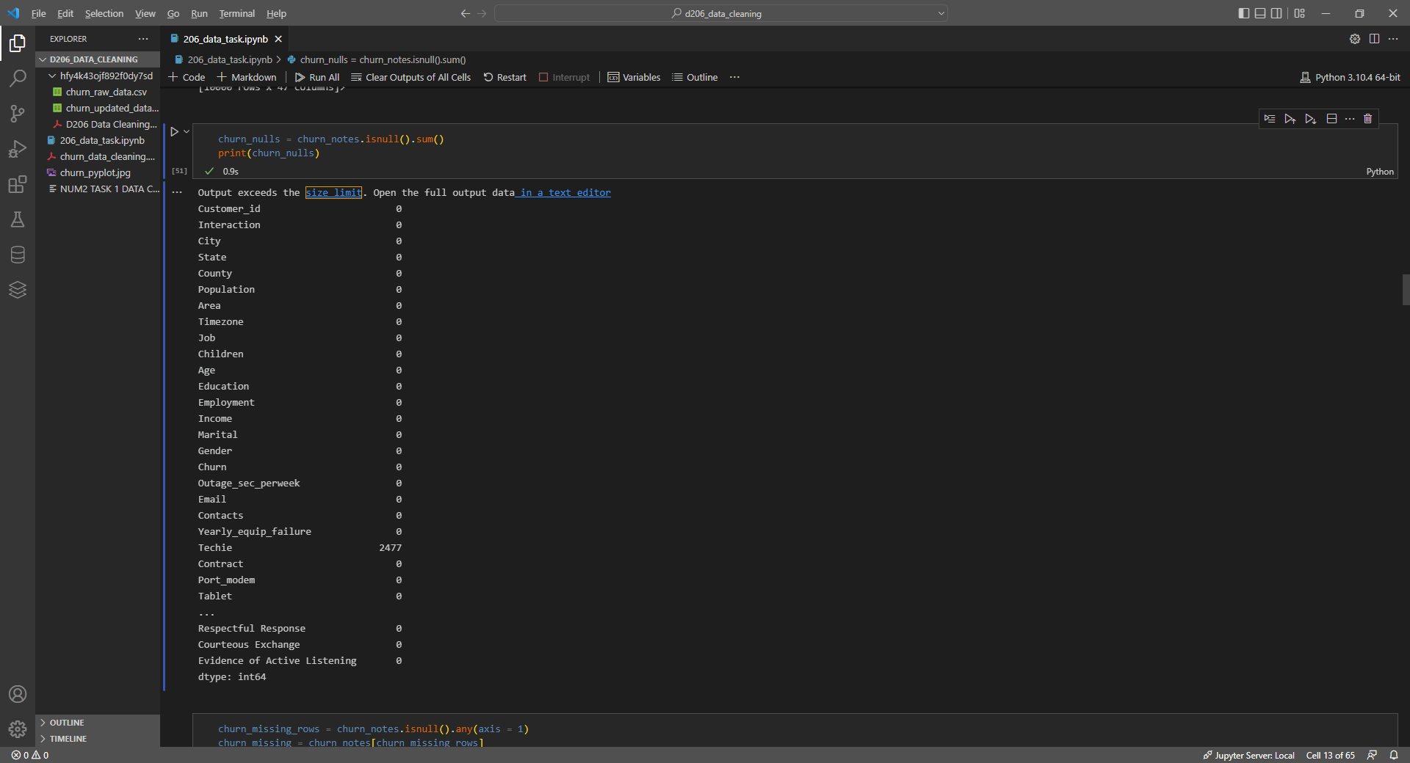
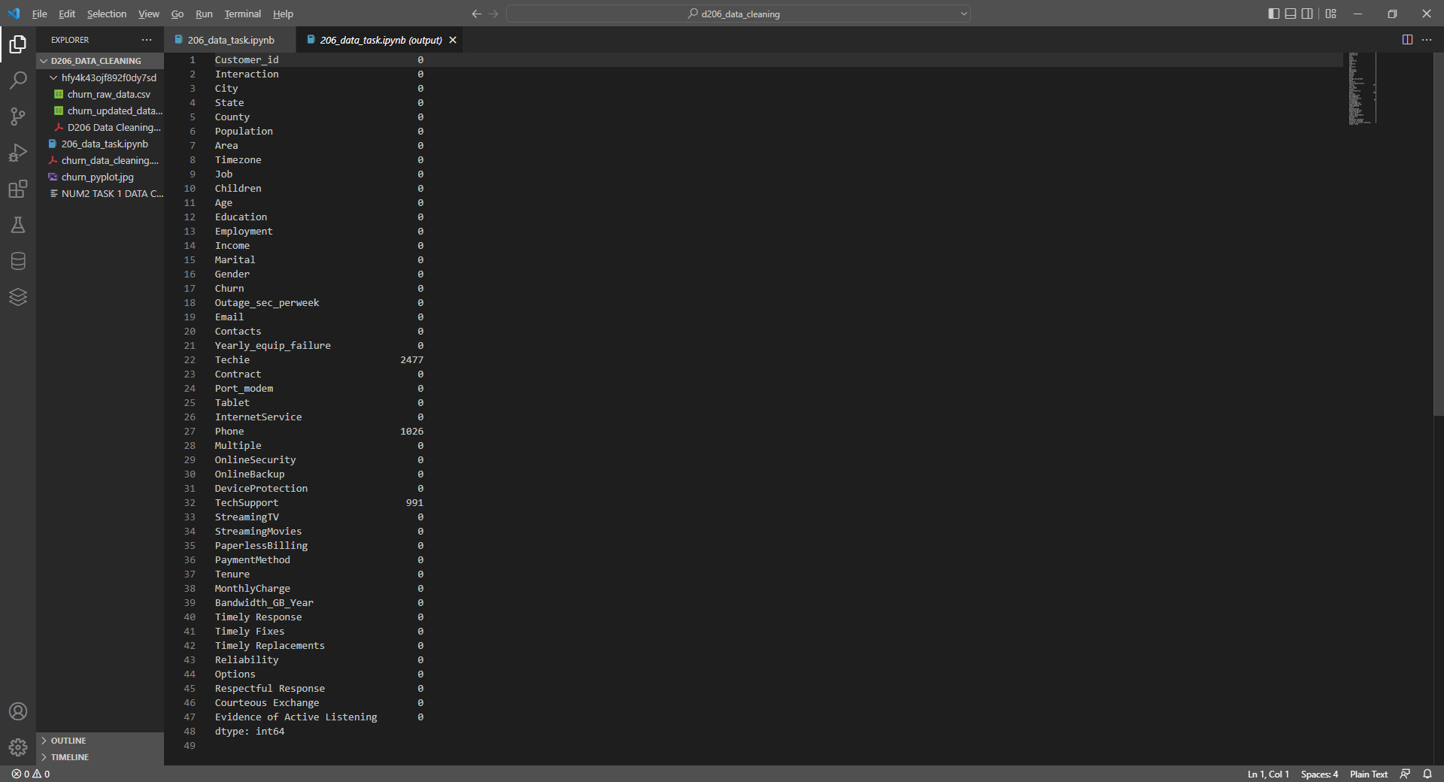
Identifying Null Values
Second, I took a closer look at the number of values in each column overall.
I paid particularly close attention to the columns that had numeric data, as opposed to categorical data, since those were the ones that made the most sense for my analysis.

Slide 21
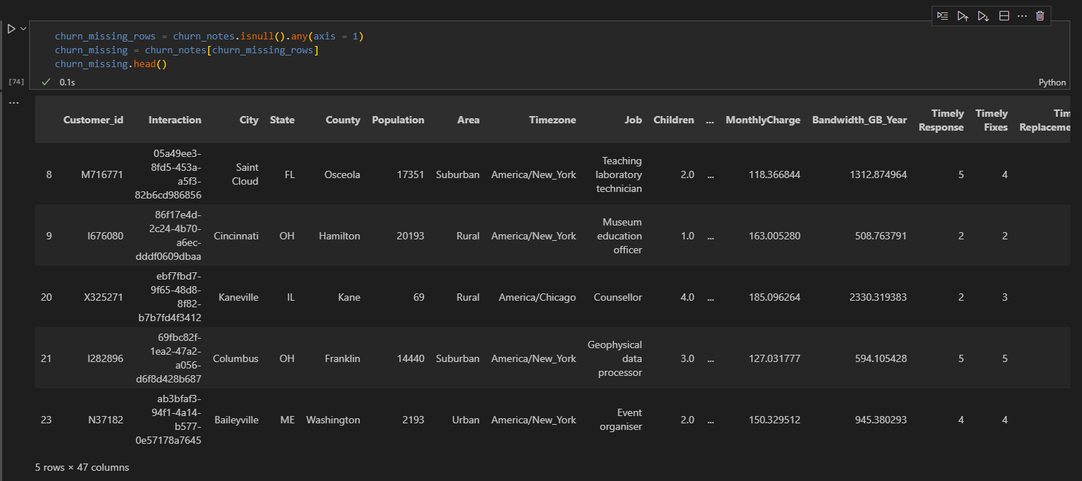
Storing Null Values
I stored the rows with missing values in a new variable so that I could keep the data organized. At this point I really needed to decide if I was going to drop the effected columns/rows or keep them in the set.
Ultimately, I decided the numerical values should be updated.

Slide 22
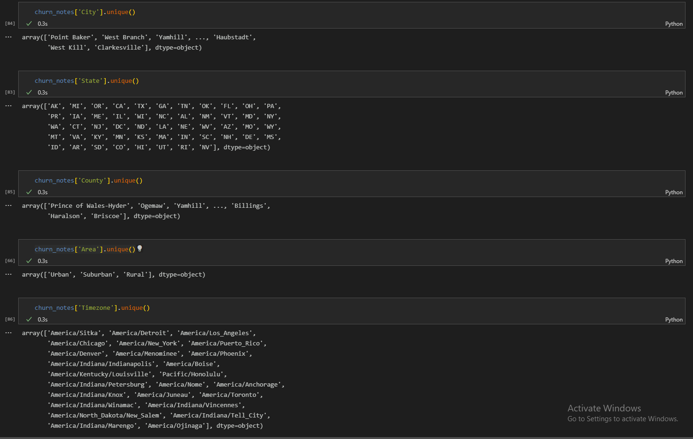
Evaluating Categorical Columns, Page 1
I used the Numpy .unique() function to look for duplicates in the columns with categorical data.
At this point, I had already begun to trim out the categories that I did not think would likely contribute to my evaluation, so I only ran the .unique() for the columns that were relevant.

Slide 23
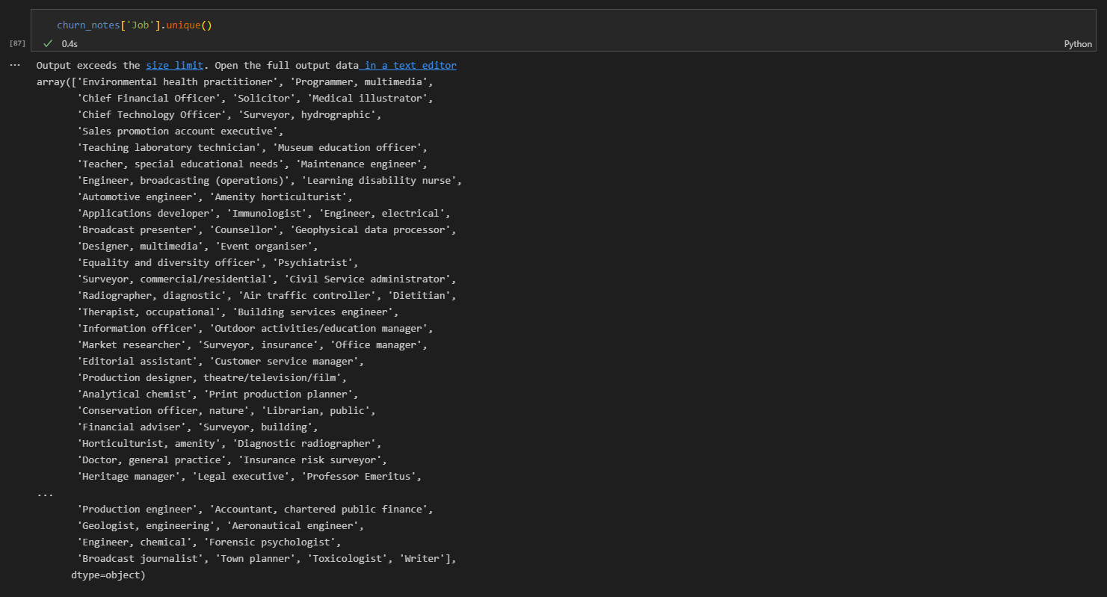
Evaluating Categorical Columns, Page 2
I used the Numpy .unique() function to look for duplicates in the columns with categorical data.
At this point, I had already begun to trim out the categories that I did not think would likely contribute to my evaluation, so I only ran the .unique() for the columns that were relevant.

Slide 24
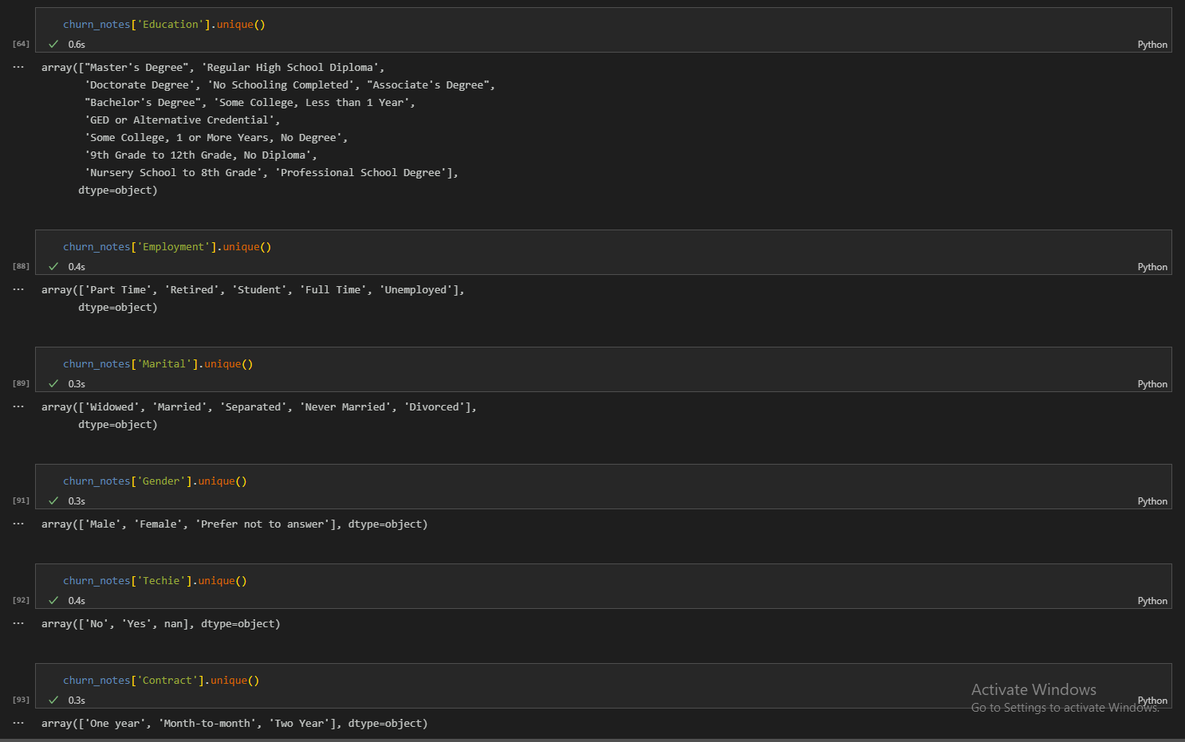
Evaluating Categorical Columns, Page 3
I used the Numpy .unique() function to look for duplicates in the columns with categorical data.
At this point, I had already begun to trim out the categories that I did not think would likely contribute to my evaluation, so I only ran the .unique() for the columns that were relevant.

Slide 25
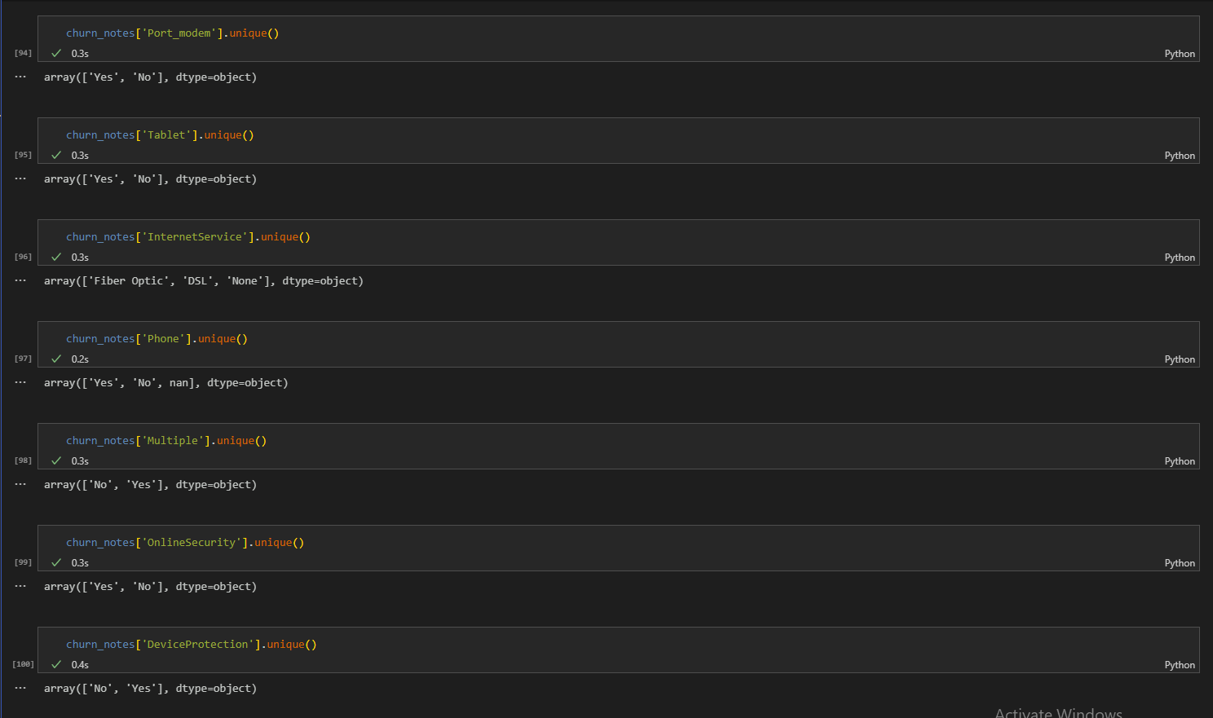
Evaluating Categorical Columns, Page 4
I used the Numpy .unique() function to look for duplicates in the columns with categorical data.
At this point, I had already begun to trim out the categories that I did not think would likely contribute to my evaluation, so I only ran the .unique() for the columns that were relevant.

Slide 26
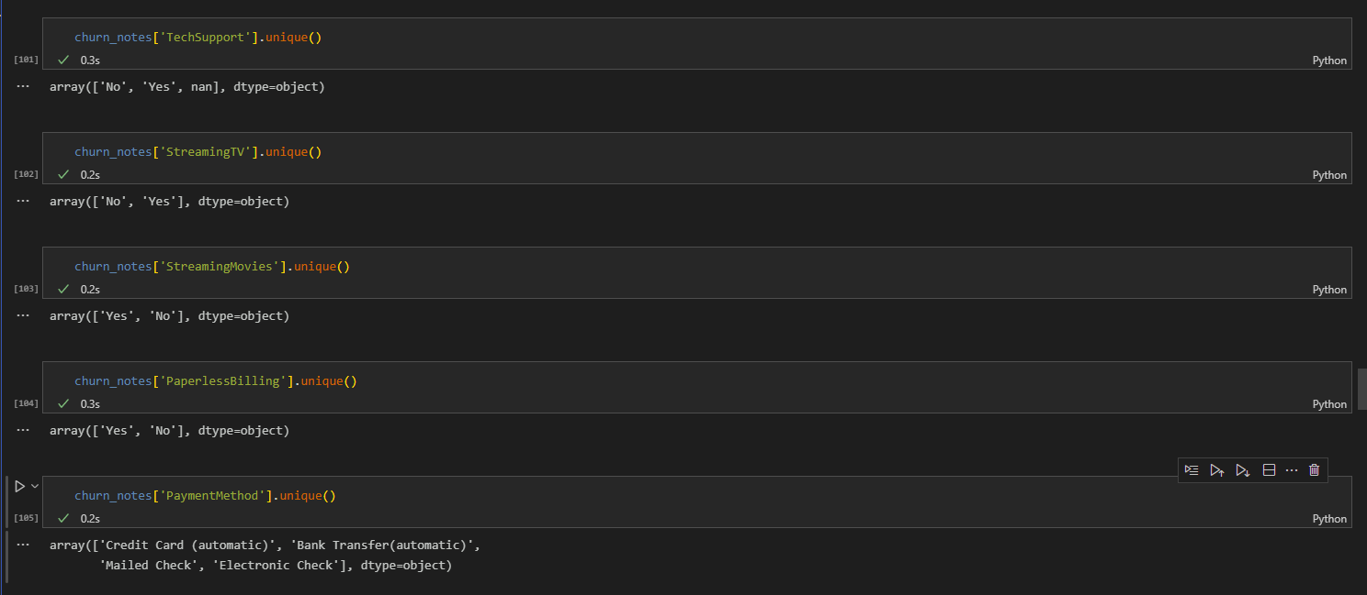
Evaluating Categorical Columns, Page 5
I used the Numpy .unique() function to look for duplicates in the columns with categorical data.
At this point, I had already begun to trim out the categories that I did not think would likely contribute to my evaluation, so I only ran the .unique() for the columns that were relevant.

Slide 27
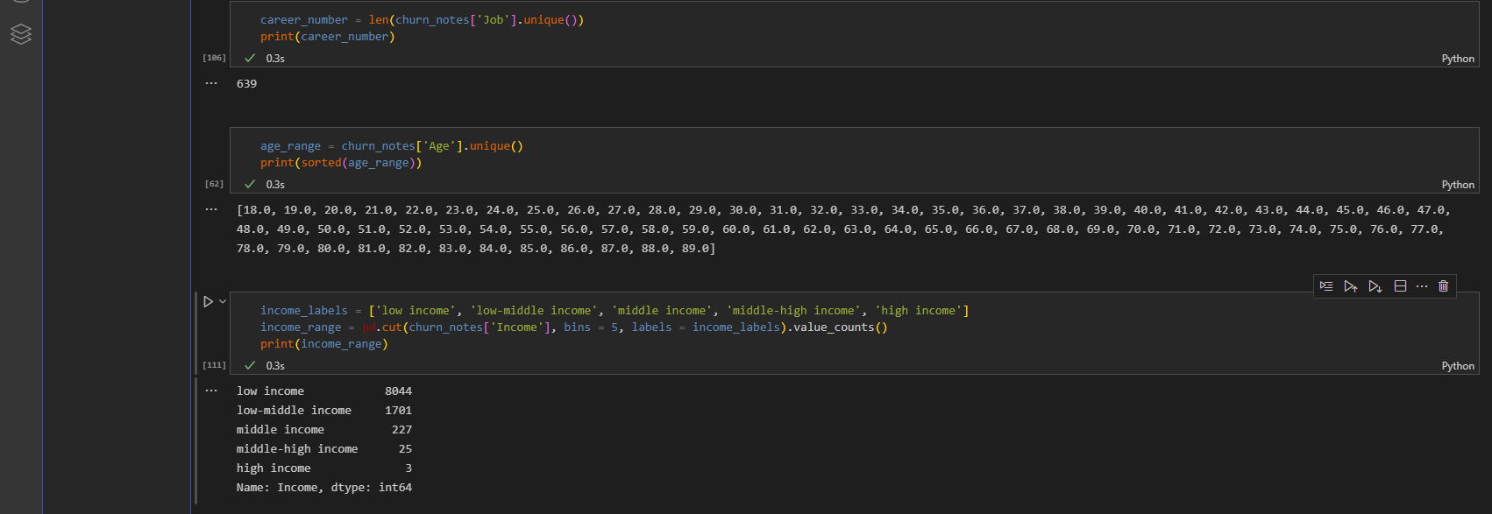
Searching Numerical Columns
I broke the numerical columns into unique values as well. Some I grouped by ranges and the others I counted their instances. This depended on the data available and what I thought it could be used for. Not many of the columns seemed to provide actionable data.

Slide 28
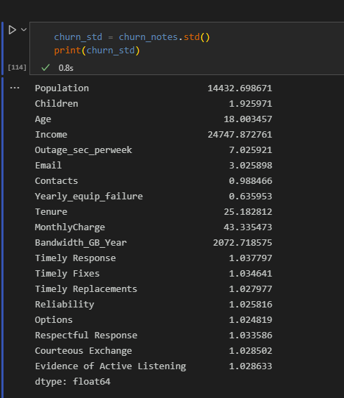
Finding the Standard Deviation
In order to update the numerical columns for Null and NA data, I needed to track the STD for each column. This would help me decide whether to use mean, median, or mode for the adjustments.

Slide 29
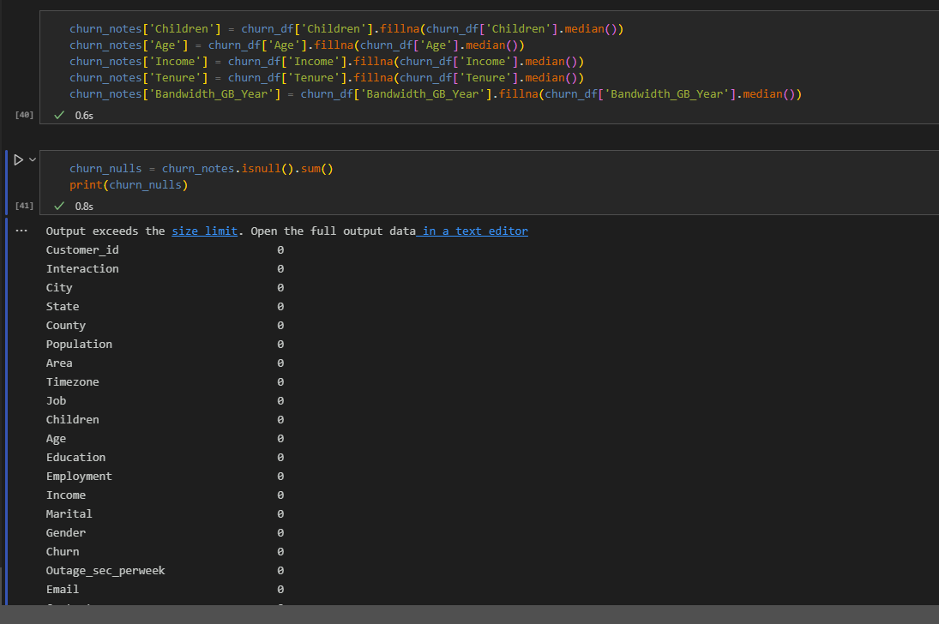
Clearing the Values
Then I cleared the columns that I felt were relevant to my needs, using the statistical deviations that made the most sense (in this case median, rather than mean to account for any outliers).

Slide 30
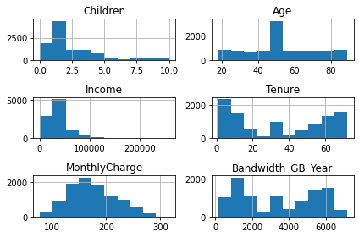
Anomaly Identification
I plot the focus variables with histograms, using matplotlib.pyplot
churn_notes[['Children', 'Age', 'Income', 'Tenure', 'MonthlyCharge','Bandwidth_GB_Year']].hist()
plt.savefig('churn_pyplot.jpg')
plt.tight_layout()

Slide 31
PCA for significant features in data
Principal components of the data set
How they were identified
How the organization can benefit from the PCA

Slide 32
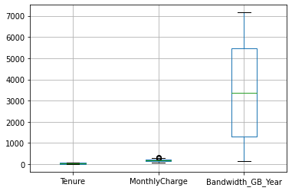
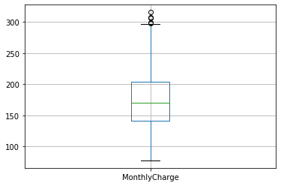
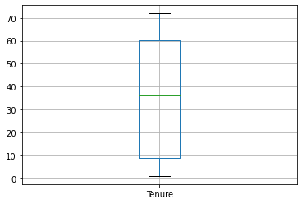
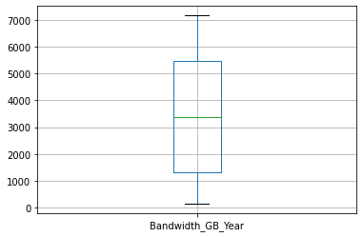
Using boxplots to further test for outliers with .boxplot
Overview
MonthlyCharge
Tenure
Bandwidth_GB_Year
churn_notes.boxplot(['Tenure', 'MonthlyCharge', 'Bandwidth_GB_Year'])
churn_notes.boxplot(['MonthlyCharge'])
churn_notes.boxplot(['Tenure'])
churn_notes.boxplot(['Bandwidth_GB_Year'])
MonthlyCharge shows signs of having outliers!

Slide 33
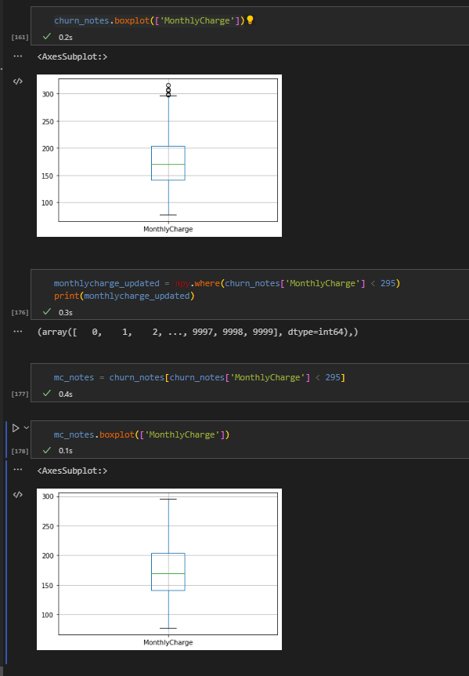
Removing Outliers
The MonthlyCharge column had outliers that were skewing the information available. I needed to remove those outliers in order to get a get and give a clear picture.
I did not want to simply drop the rows, because each entry hold information that is important to different evaluations. I also felt that the MonthlyCharge column may be important in the long run.
I used Numpy to ascertain which values were above the upper limits of the box plot. Then I ran a sanity check in order to ensure the updated data would result in a more balanced plot.

Slide 34
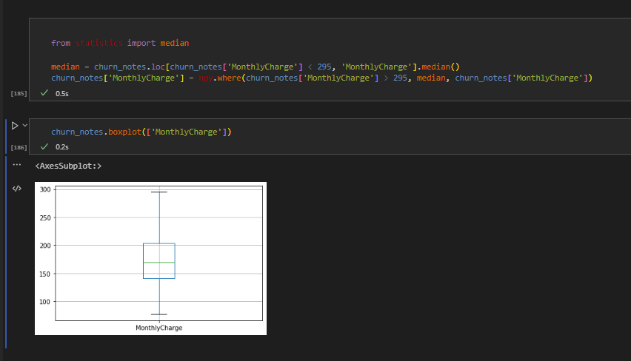
Removing Outliers
I had to import median from Numpy’s statistics package in order to use median to pull the median value for the MonthlyCharge data. I did this, rather than calculating it manually due to accuracy and scalability.
I, again, went with median instead of mean due to the expansive nature of the data set.

Slide 35
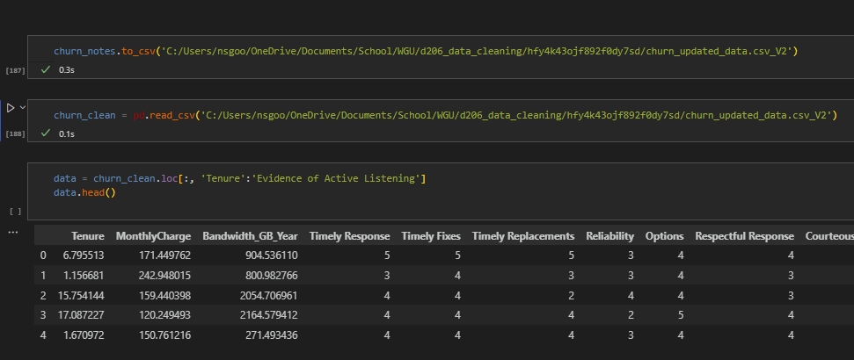
Extracting Updated Data
I extracted the cleaned dataset and removed all of the data that I felt was not necessary for my analysis. This step was particularly difficult after spending so much time cleaning columns that would ultimately not be used, but (for example) once I had time to look at the MonthlyCharge data without outliers, I realized that the distribution was pretty even—meaning I would be statistically unlikely to draw correlation between the information and the churn rate. I focused, instead, on customer satisfaction metrics. I kept it in the overall structure to use as a stopgap because I knew it had been heavily adjusted for accuracy.

Slide 36
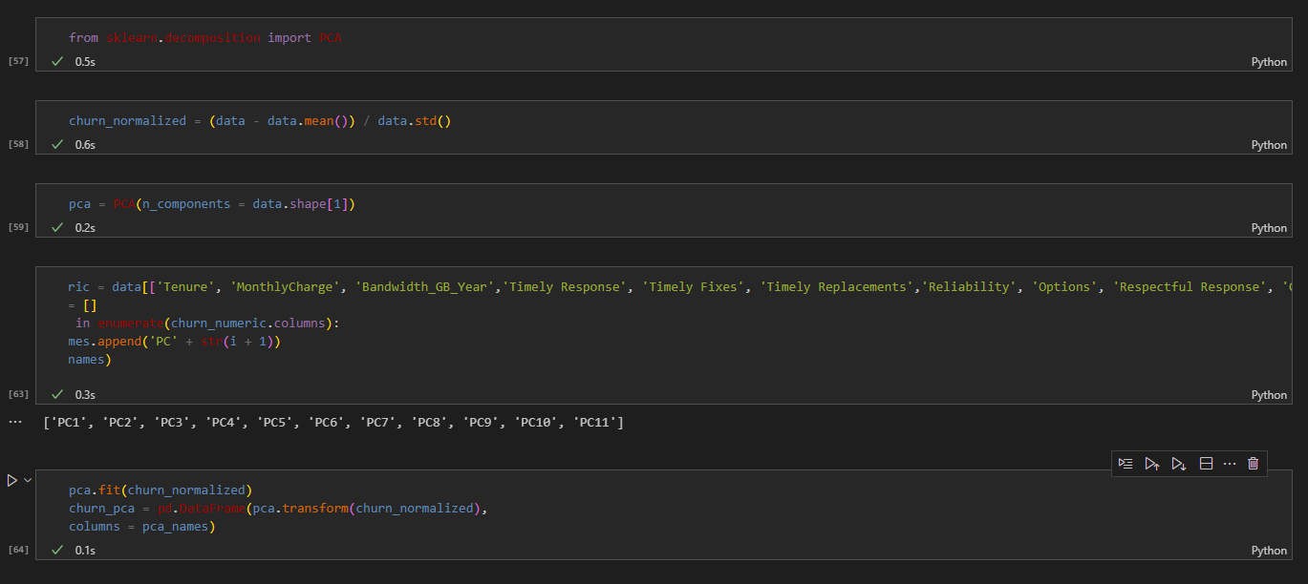
Principal Component Analysis
Utilizing Scikit Learn application, I normalize the data first and then select which variables to use in my analysis. Next, I had to create a list of the names for the PCA, since the column names are a bit cumbersome. Finally, I used the PCA application to change the dataset into components.

Slide 37
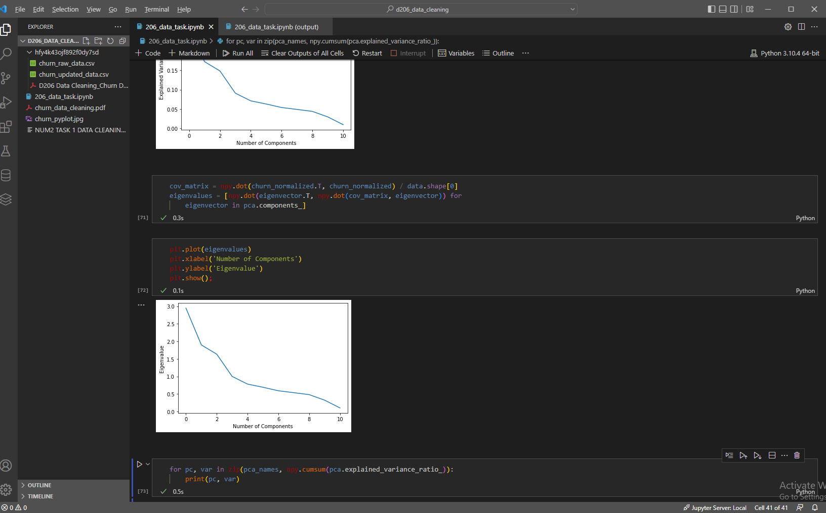
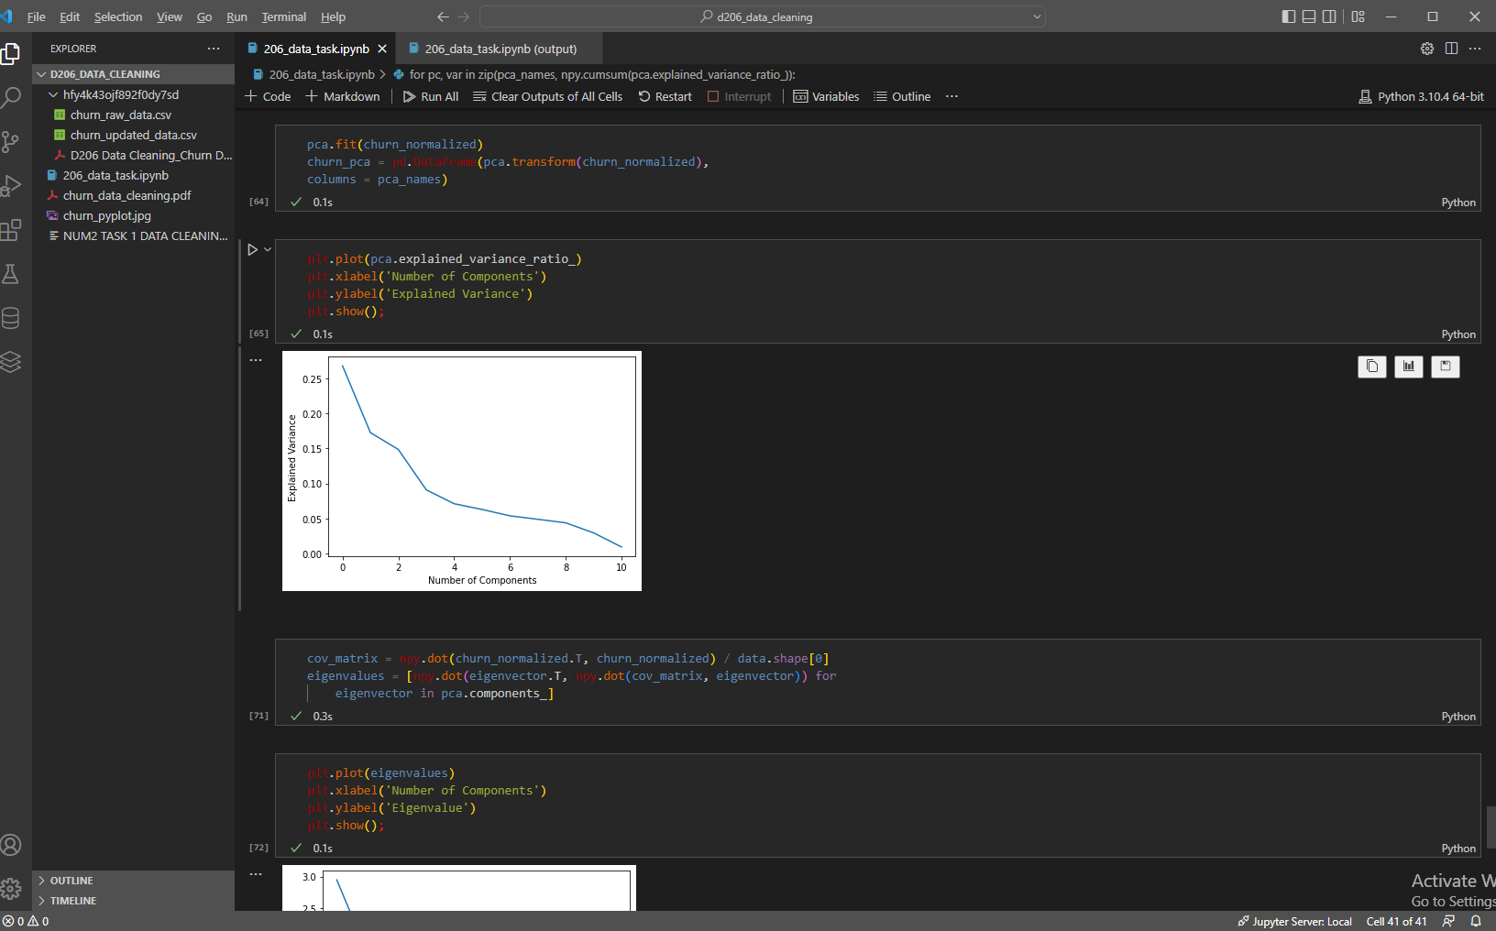
Creating and Refining Scree Plots
I decided to utilize a scree plot in order to better visualize the impact my principal components had on the overall evaluation. In this particular case, the eigenvalues helped me make sense of the order I should be looking at the various components—and they’re overall potential impact on the research question.
Ultimately, I used the scree plot to narrow my focus from the list of components, since scree plots tell the user how much of the total variation in a dataset is the result of each component.

Slide 38
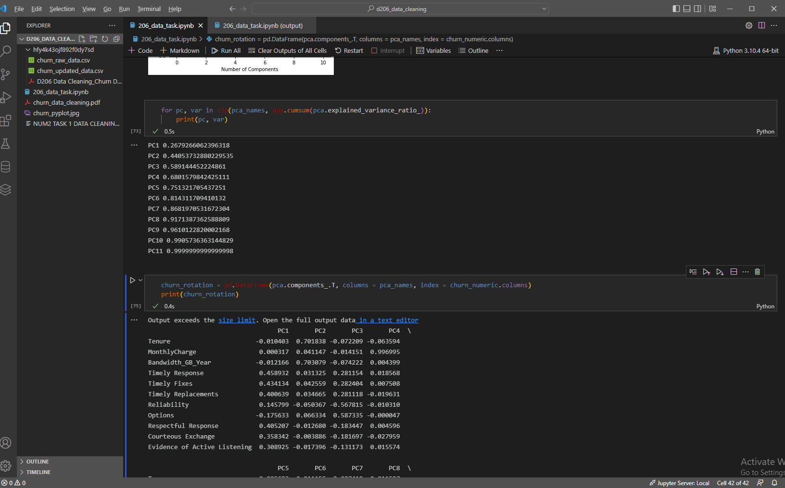
Creating a Rotation
After separating out some of the components it became clear that a large chunk of the variance comes from a small subset.
I used a rotation in order to better to minimize the complexity of the set and to make the overall structure easier to understand.

Slide 39
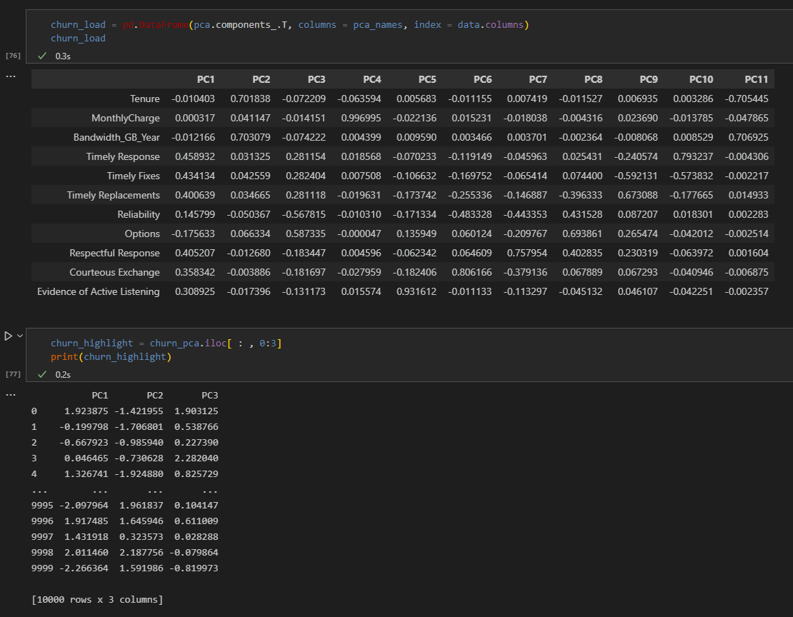
Finalizing Data Findings
Now that I’d cleaned up the data and highlighted the primary markers for answering my research question, I can extract the data for end users.
I loaded the output for the components and then extracted just what needed to be looked at in the final analysis.
The company can benefit from this analysis by looking directly at these identified pain points and making adjustments that will lower churn rate.

Slide 40
PCA Application : Principal Components and Criteria
Principal Components: Timely Responses, Timely Fixes, Timely Replacements, and Respectful Response columns.
Criteria: Based on real-world knowledge, I felt that these specific columns were indicative of customer satisfaction—and important factor when analyzing churn. There was also the consideration of Churn itself; however, when utilizing various plotting options (scree, scatter, and histogram), it became apparent that some components were more relevant than others.
Once I realized that 7 components made up over 86% of the cumsum method, it was easy to justify creating a rotation with them as the most vital bits of information. After that point, narrowing my selection further boiled down to measurable impact when comparing each to the churn rate.

Slide 41
PCA Application : Company Benefits
Quantifiable SMART Goals
By utilizing this analysis, stakeholders in the company can build business campaigns that are SMART (Specific, Measurable, Achievable, Relevant, and Time-Bound). Because we have identified specific components that have an impact on churn rate, those stakeholders can target those metrics when implementing training and like resources to improvements.
In that case, the communications company can continue to improve by measuring these specific components and tracking how improving them affects their churn rate. As Sophia Martin, PHD noted, “Analytics is the checks and balances of business decisions.” (Martin, 2019)

Slide 42

Summary of Outcomes, Part 1
Findings: My initial findings highlighted how much missing data there was in the set. While there was enough to get an overall answer to the research question, much of the errors or missing data seemed to be human error. That said, the input method for categorical data revealed that many of the columns I had initially pulled for analysis were not viable or relevant. There were anomalies in one of the columns that I ultimately used (MonthlyCharge) but these were easily circumvented.
Mitigation Method: I used a median imputation to mitigate the general outliers in my data. I did this because I saw that using the mean would skew the information too far beyond the standard deviation. The fact that there were only a few outliers made taking the median the best course. In doing so, I also had to utilize Numpy’s Statistics function.
After evaluating all of the possible columns, I narrowed the focus of the communications company to the ones that had the strongest statistical values. Based on this analysis, the company can look at the impact of Churn vs. each individual column.

Slide 43
Summary of Outcomes, Part 2
My mitigation code is straight-forward and clean. For the most part, I had trouble running too many “sanity” checks to make sure I was following the right path. This is documented in my Panopto recording.
The cleaned data can be found in the ‘churn_updated_data’ sheet that I have attached to this assignment. It was produced through VSC and can be marked in my Panopto recording.
The limitations of this data essentially boil down to the fact that the communications company does not have a set reference for how they input data. Many of the current missing values are based on either user error or a blank answer. By updating their processes, the company is likely to find more evergreen information to work with and identify the cause of their churn rates.
Due to the missing data, the analysis given in this report may be skewed slightly. The best way to improve on these limitations would be stronger processes in the data collection step, as well as stricter input expectations.

Slide 44


Sources for Third-Party Code
“Python: Replacing Outliers Values With Median Values.” Stack Overflow, 29 July 2017, stackoverflow.com/questions/45386955/python-replacing-outliers-values-with-median-values.
pandas.DataFrame.median — Pandas 1.4.4 Documentation. pandas.pydata.org/docs/reference/api/pandas.DataFrame.median.html. Accessed 17 Sept. 2022.
Zach. “How to Create a Scree Plot in Python (Step-by-Step).” Statology, 18 Sept. 2021, www.statology.org/scree-plot-python.
Marsja, Erik. “Pandas Count Occurrences in Column – i.e. Unique Values.” Erik Marsja, 8 Sept. 2021, www.marsja.se/pandas-count-occurrences-in-column-unique-values.

Slide 45
References
Davenport, Thomas H.; Patil, D. J. (October 2012). "Data Scientist: The Sexiest Job of the 21st Century". Harvard Business Review. 90 (10): 70–76, 128. PMID 23074866. Retrieved September 10, 2022.
Martin, Sophia (20 September 2019). "How Data Science will Impact Future of Businesses?". Medium. Retrieved September 14, 2022.
Woodie, A. (2019, August 15). Is Python Strangling R to Death? (T. index, Ed.) datanami: data science ai advanced analytics, 3-4. Retrieved September 13, 2022, from https://www.datanami.com/2019/08/15/is-python-strangling-r-to-death/
Wu, C. F. Jeff (1986). "Future directions of statistical research in China: a historical perspective" (PDF). Application of Statistics and Management. 1: 1–7. Retrieved September 12, 2022.

